Slide 1


Semantic Patterns for Sentiment Analysis of Twitter
Hassan Saif, Yulan He, Miriam Fernandez and Harith Alani
The 13th International Semantic Web Conference (ISWC2014)
May 2014

Slide 2
OutLine
Sentiment Analysis
Traditional Sentiment Analysis
Pattern-based Sentiment Analysis
Semantic Sentiment Patterns
Evaluation
Results
Conclusion

Slide 3



Sentiment Analysis
“Sentiment analysis is the task of identifying positive and negative opinions, emotions and evaluations in text”
The weather is great today :)
I think its almost 30 degrees today
Nooo, it is very humid :(
Opinion
Fact
Opinion

Slide 4
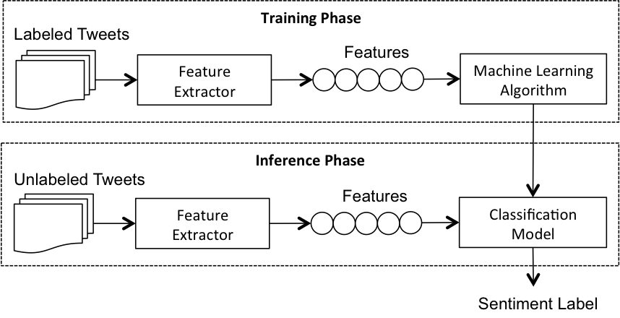
Traditional Sentiment Analysis
(1) The Lexicon-based Approach
Sentiment Lexicon
Just got my new iPhone 6, looks and feel great! :D
wrong
mistake
horrible
great
pretty
beautiful
sad
down
good
(1) The Machine Learning Approach
Training Features:
Syntactic features (letter, n-grams, word n-grams, POS tags, etc)
Linguistic Features (Synonyms, glosses, etc)

Slide 5
Traditional Sentiment Analysis
However..
Sentiment is often expressed via more subtle relations, patterns and dependencies among words in tweets:
Destroy Invading Germs
Negative
Negative Concept
Positive Sentiment

Slide 6
Pattern-based Sentiment Analysis
Syntactic Pattern Approaches
Semantic Pattern Approaches

Slide 7
Syntactic Pattern Approaches
Based on syntactic relations between words.
Rely on predefined POS templates:
But, they are Semantically Weak!
<subject> passive-verb
<subject> active-verb
<customer> was satisfied
<she> complained
<beer> is cold
<subject> verb cold
<weather> is cold

Slide 8
Semantic Pattern Approaches
Apply syntactic and semantic processing techniques
Use external semantic resources (Ontologies, Semantic Networks, etc.)
Capture the conceptual semantic relations in text that implicitly convey sentiment
Happy birthday (Positive)
Invading Germs (Negative)

Slide 9
Syntactic & Semantic Pattern Approaches
are not tailored to
Twitter

Slide 10

Syntactic & Semantic Pattern Approaches
Are designed to function on
Formal Text, that is:
Long enough
Well-Structured
Formal Sentences

Slide 11

Tweets are often
Short!
Noisy and messy
Have informal, and ill-structured sentences

Slide 12
We Propose..
A pattern-based approach
Works on Twitter
Does not rely on the syntactic structures of tweets or pre-defined syntactic templates
Does not rely on or semantic knowledge sources.
Automatically extracts patterns from the contextual semantic and sentiment similarities of words in tweets

Slide 13
Contextual Semantics and Sentiment
Contextual Semantics
Contextual Semantics refer to semantics inferred from words’ co-occurrences in tweets.
“Words that occur in similar context tend to have similar meaning”
Wittgenstein (1953)
Greek
Tale
Threat
Dangerous
Hack
Troy
Code
History
Trojan Horse
Program
Trojan Horse
Harm
Wooden
Class
Malware

Slide 14
Contextual Semantic Sentiment Patterns
“Some words in different tweets tend to come with similar contextual semantics and sentiment, forming therefore specific clusters or patterns.
Hack
Threat
Dangerous
Spyware
Code
Trojan Horse
Program
Harm
Malware

Slide 15
Contextual Semantic Sentiment Patterns
Negative Contextual Pattern
Hack
Follow
Threat
C_Semantics(Worms)
Follow
Dangerous
C_Semantics(Adware)
Follow
Spyware
Code
C_Semantics(Time bombs)
Trojan Horse
Program
Harm
Malware

Slide 16
Pattern Extraction
Pipeline
Syntactical Preprocessing of tweets
Capturing the Contextual Semantics and Sentiment of words
Extracting Semantic Sentiment Patterns

Slide 17
(1) Syntactical Preprocessing
All URL links are replaced with the term “URL”
Remove all non-ASCII and non-English characters
Revert words that contain repeated letters to their original English form.
“maaadddd” will be converted to “mad” after processing.

Slide 18
(2) Capturing Contextual Semantics & Sentiment
SentiCircle of “Trojan Horse”
The SentiCircle Approach
Very Positive
+1
Positive
Context Terms
Term (m)
C1
useful
discover
C1
Dangerous
fix
Trojan Horse
easily
x_{i}
+1
-1
Neutral
Region
X
attack
θ_{i}
Prior Sentiment
destroy
y_{i}
r_{i}
Malicious
threat
Dangerous
Degree of Correlation
Very Negative
-1
Negative
r_{i} = TDOC(C_{i})
θ_{i} = Prior_Sentiment (C_{i}) * π
Overall Contextual Sentiment (Senti-Median)
X = R * COS(θ) Y = R * SIN(θ)
Saif, H., Fernandez, M., He, Y. and Alani, H. (2014) SentiCircles for Contextual and Conceptual Semantic Sentiment Analysis of Twitter, ESWC2014

Slide 19
(3) Extracting Semantic Sentiment Patterns
Patterns are extracted by finding clusters of Similar SentiCircles
Obama
iPod
SentiCircle’s Feature Vector
(1)
Oprah
Geometry
Density
Dispersion
Spyware
SS-Patterns
K-means
(2)
SentiCircle’s Feature Vectors

Slide 20
Evaluation
Entity-level Sentiment Analysis
SS-Patterns
Detect the sentiment (Positive, Negative, Neutral) of named entities extracted from tweets
Training Sentiment Classifiers
Tweet-level Sentiment Analysis
Detect the overall sentiment (Positive, Negative) of a tweet.

Slide 21
Evaluation Setup (1)
Sentiment Classifiers
Tweet-Level
Maximum Entropy (MaxEnt)
Naïve Bayes (NB)
Entity-Level
MLE Classifier

Slide 22
Evaluation Setup (2)
Datasets
Tweet-level
9 Twitter datasets
Entity-Level
58 manually annotated named entities

Slide 23
Evaluation Setup (3)
Baseline Features
Syntactic Features
Unigrams | Individual unique terms in tweets
POS Features | Words’ part-of-speech tags
Twitter Features | Usernames, emoticons, hashtags, etc
Lexicon Features | Prior sentiment of words in a given sentiment lexicon(e.g., great->positive, destroy->negative)
Semantic Features
LDA-Topic Features | Topics generated by LDA
Semantic Concepts | Semantic concepts of named entities in tweets (e.g., Obama -> Person, London -> City)

Slide 24
Results

Slide 25
Tweet-Level Sentiment Analysis (1)
The baseline model is a sentiment classifier trained from word unigram features.
MaxEnt outperforms NB in average Accuracy and F1-measure

Slide 26
Tweet-Level Sentiment Analysis (2)
Win/Loss in Accuracy and F-measure of using different features for sentiment classification on all nine datasets.

Slide 27
Entity-Level Sentiment Analysis
SS-Patterns produce 6.31% and 7.5% higher accuracy and F-measure than other features

Slide 28
Within-Pattern Sentiment Consistency
Refers to the percentage of words having similar sentiment within a given pattern.
Strongly consistent patterns are those whose terms have similar sentiment.

Slide 29
Within-Pattern Sentiment Consistency
STS-Entity Dataset:
58 Entities 14 SS-Patterns
Consistency(Pattern12) = 88.89%
(Strongly Consistent)
Consistency(Pattern5) = 50%
(Poorly Consistent)
Average Sentiment Consistency (14 SS-Patterns) = 88%

Slide 30
Conclusion
We proposed a new approach for automatically extracting patterns from the contextual semantic and sentiment similarities of words in tweets.
Used patterns as features in tweet- and entity-level sentiment classification tasks
SS-Patterns consistently outperformed the syntactic and semantic type of features for entity- and tweet-level sentiment analysis
Conducted quantitative analysis on a sample of our extracted SS-Patterns and show that our patterns are strongly consistent with the sentiment of the words within them.

Slide 31
Thank You
Email: hassan.saif@open.ac.uk
Twitter: hrsaif
Website: tweenator.com

